Slide 1



AI BASED CHATBOT TO ANSWER FAQ’S
TEAM MEMBERS
NAVADEEP REDDY 2010030313
VENKATESH 2010030359
SHASHIKANTH 2010030494
MANOJ 2010030503
AKHIL REDDY 2010030513

Slide 2

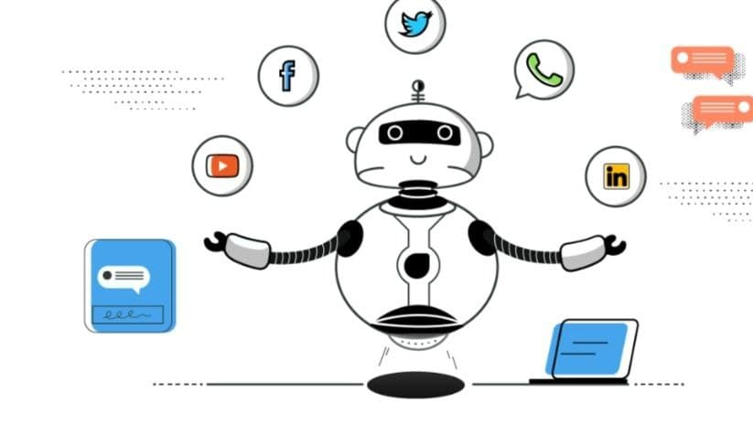
TABLE OF CONTENTS
Abstract
Project Area
Literature Survey
Problem Statement

Slide 3
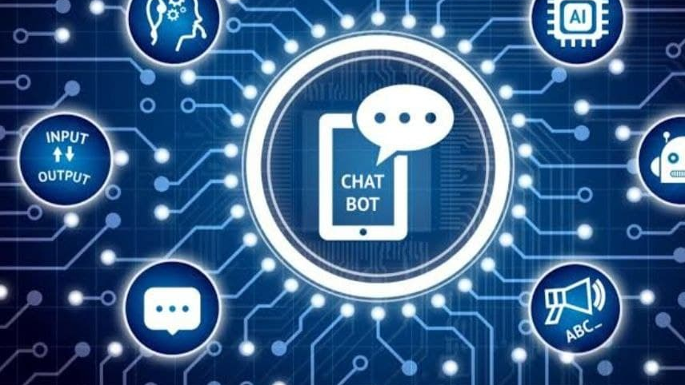
abstract
There have always been queries of people regarding various topics to which answers are provided manually by people.
In order to make this process fast the FAQs can be answer using the latest AI technologies where answers can be automatically generated according to the questions.
Also, for every question asked it can be stored and the list of questions can be increased to provide better mapping of question and answers.
This process can reduce lot of work pressure for both the consumer and the government. Also providing quick responses and suggestions can help in the better economical market growth.

Slide 4
Literature review
S.No | Title | Author | Publishing date | Journal
1 | Critical Literature Review on Chatbots in Education | Hephzibah Thomas | September-October 2020 | International Journal of Trend in Scientific Research and Development (IJTSRD)
2 | REVIEW OF AI CHATBOT | Prashanth , Rakshith Gowda , Sourabh Kakade, Gouramma, Vivek Sharma | 05 | May 2020 | International Research Journal of Engineering and Technology (IRJET)

Slide 5
Literature review
S.No | Title | Author | Publishing date | Journal
3 | Intelligent Chatbot | Munira Ansari, Mohammed Saad Parbulka | NREST - 2021 | International Journal of Engineering Research & Technology (IJERT)

Slide 6
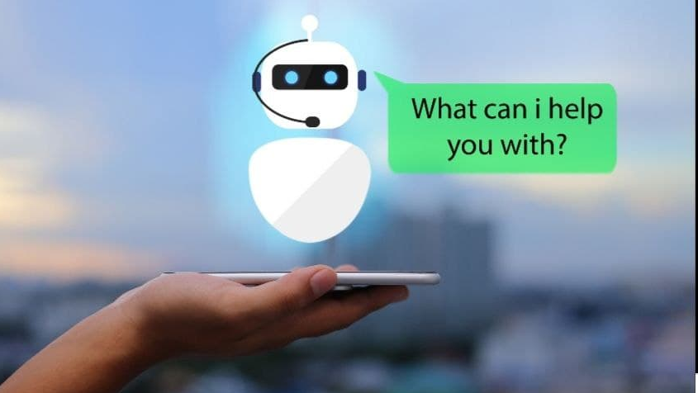
PROBLEM STATEMENT
All the companies want their clients to know about them and they can get more projects or sell their products. So, the most primary way to do this is to have a good interactive website in the advanced world of digital marketing.
But in this advanced world, just having a website is not enough as it does not cover all the details and can not solve the queries of the clients. Maybe a comment section is an answer, but it's tedious work, and 'time is money' your client will not wait too long for your response. And you can not assign humans to answer everyone at the same time twenty-four by seven.
So, for that, you need a chatbot, not a normal one "An Intelligent Chatbots” with Artificial Intelligence technology. “Artificial intelligence chatbot is a technology that makes interactions between man and machines using natural language possible
As numerous chatbot platforms already exist, there are still some problems in building data-driven system because a huge amount of data is required for their development

Slide 7

THANK YOU

